Slide 1
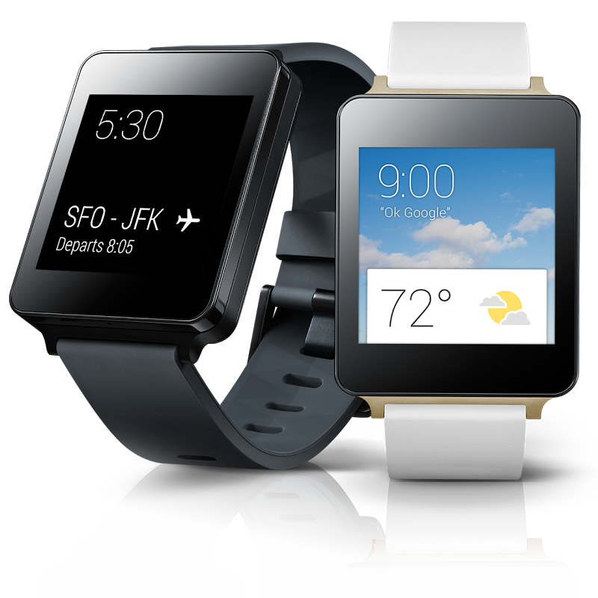
Developing Your First Android Wear App
James Montemagno
Developer Evangelist, Xamarin
@JamesMontemagno

Slide 2
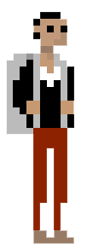



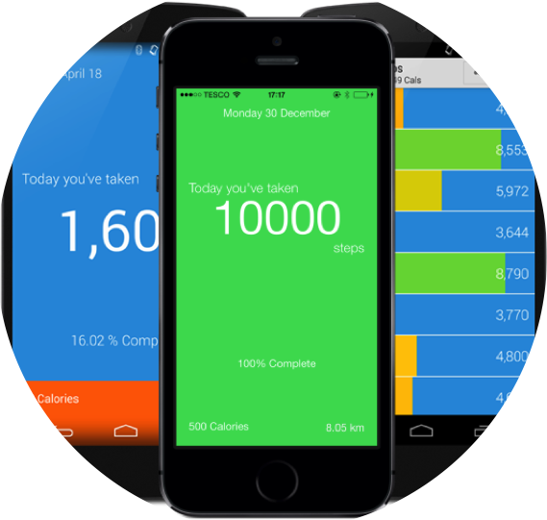
Who is this guy?
James Montemagno
Developer Evangelist, Xamarin
@JamesMontemagno
http://motzcod.es
github.com/JamesMontemagno

Slide 3
What is a wearable?

Slide 4


Slide 5


Slide 6
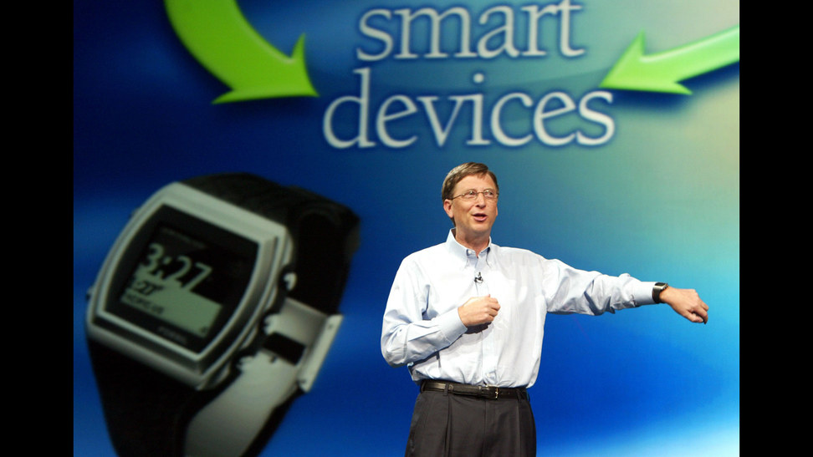


Slide 7
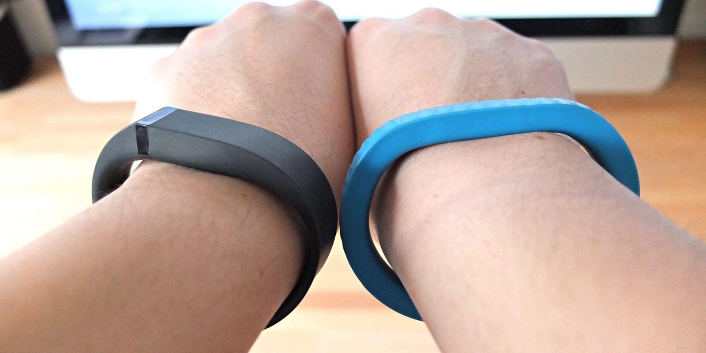
Image: http://blog.apphappening.com/

Slide 8
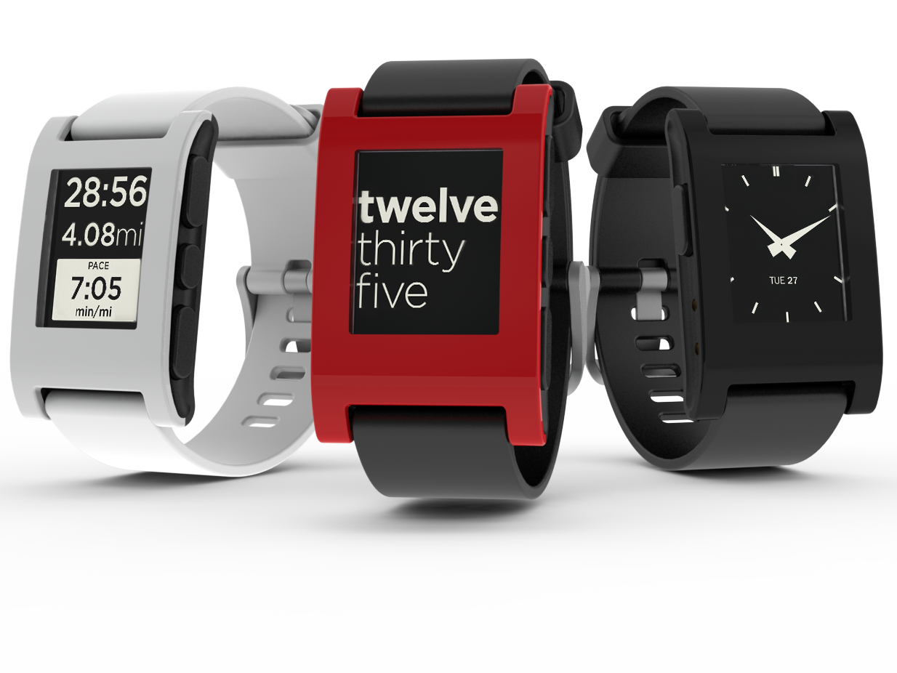

Slide 9


Slide 10


Slide 11
What is Android Wear?

Slide 12


Slide 13

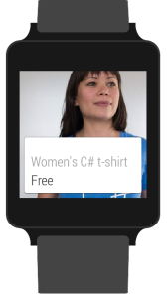
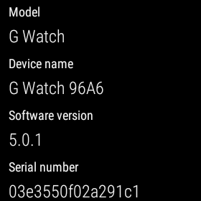
Android Wear
Android 5.0.1
No Access To:
Android.Webkit
Android.Print
Android.App.Backup
Android.AppWidget
Android.Hardware.Usb
Sensor Support
Call HasSystemFeature() before using API

Slide 14

Bluetooth 4.0 Low Energy
Used for all communication

Slide 15
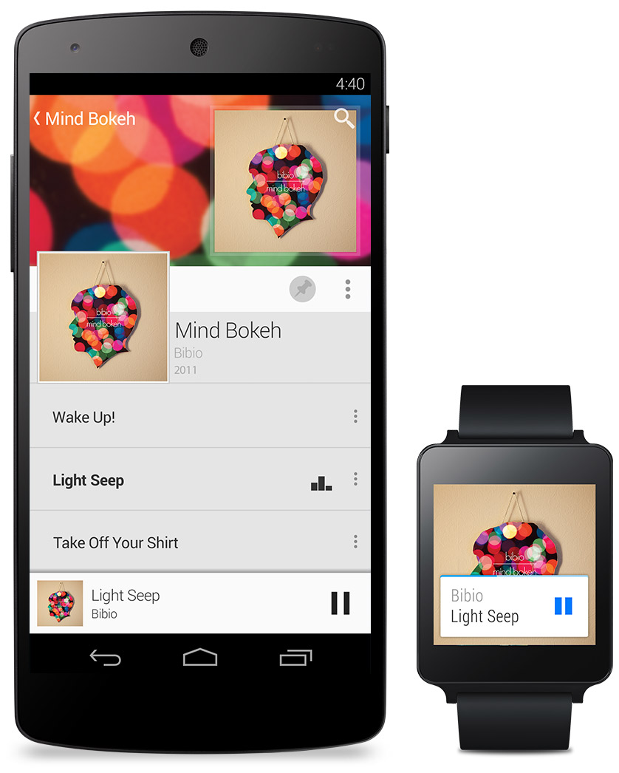
Android Phone Required!
Android 4.3+ (40% of devices in market)
Android Wear App
Bluetooth LE Required
http://g.co/WearCheck

Slide 16
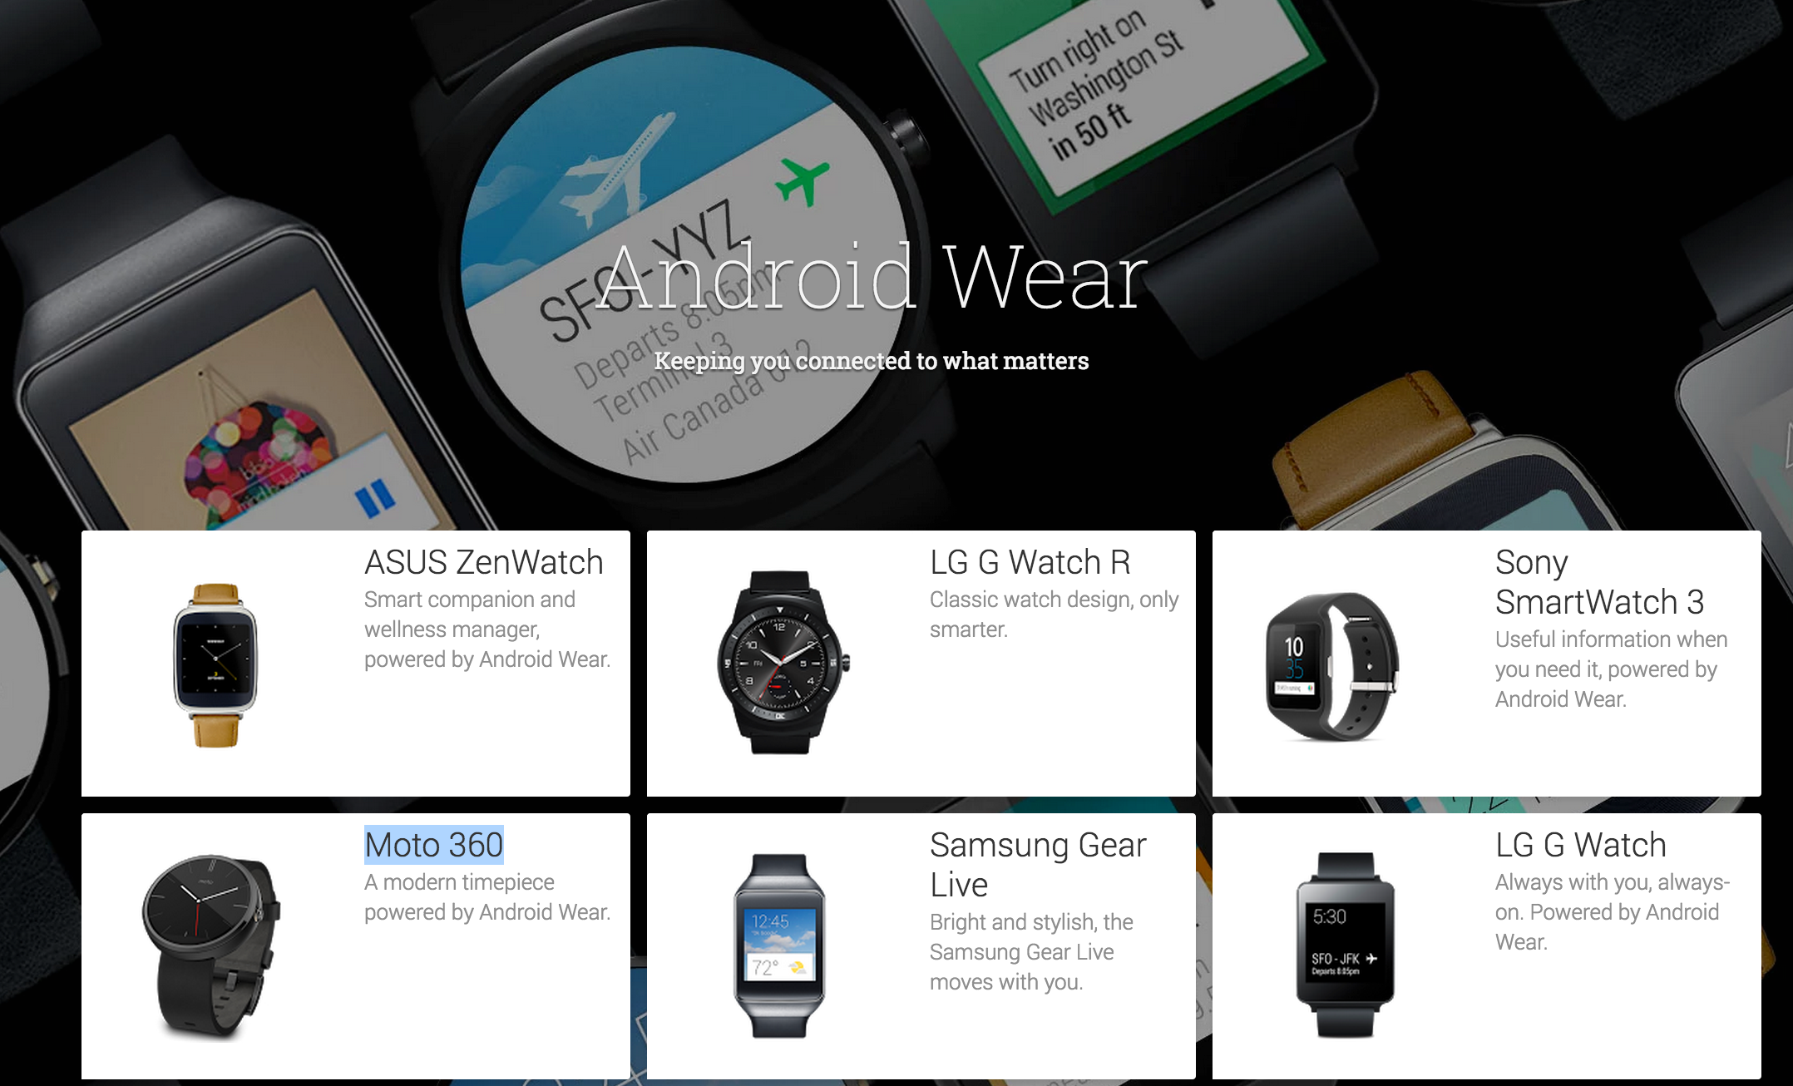

Slide 17
What can we do?

Slide 18
Notifications Companion Apps Watch Faces

Slide 19
Notifications Companion Apps Watch Faces

Slide 20
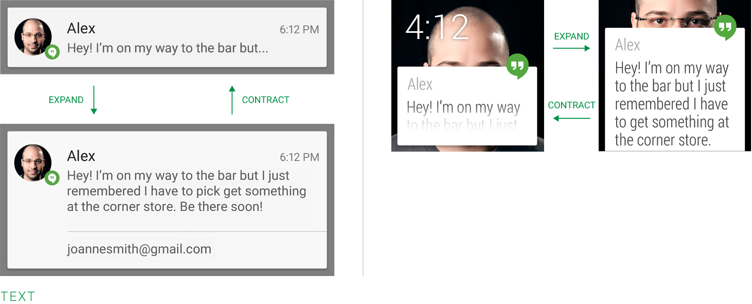
Notifications

Slide 21
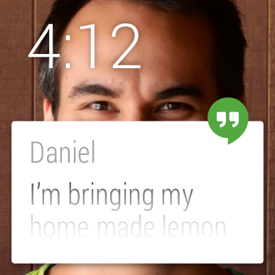
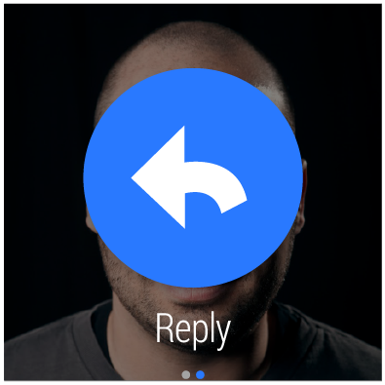
Notifications - Actions

Slide 22
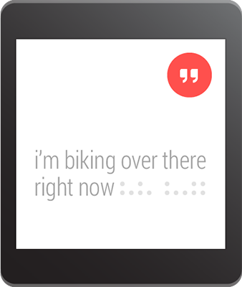
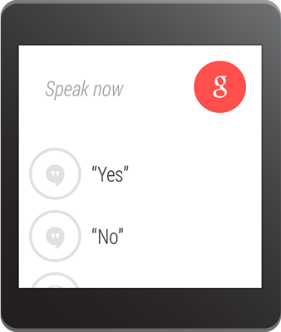
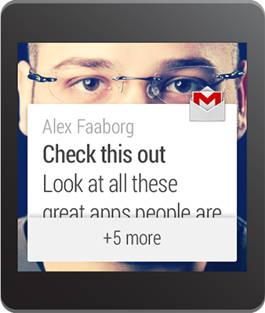

Extending Existing Notifications
Lazy, but very effective!
Uses Notification.WearableExtender
Custom Backgrounds
Actions specific for Wear
Remote Input
Voice Input
Predefined actions
Pages, Stacking, and More!
http://www.nuget.org/packages/Xamarin.Android.Support.V4/
Notes:
Only available in Android L Developer Preview

Slide 23
Demo

Slide 24
What is Xamarin?

Slide 25
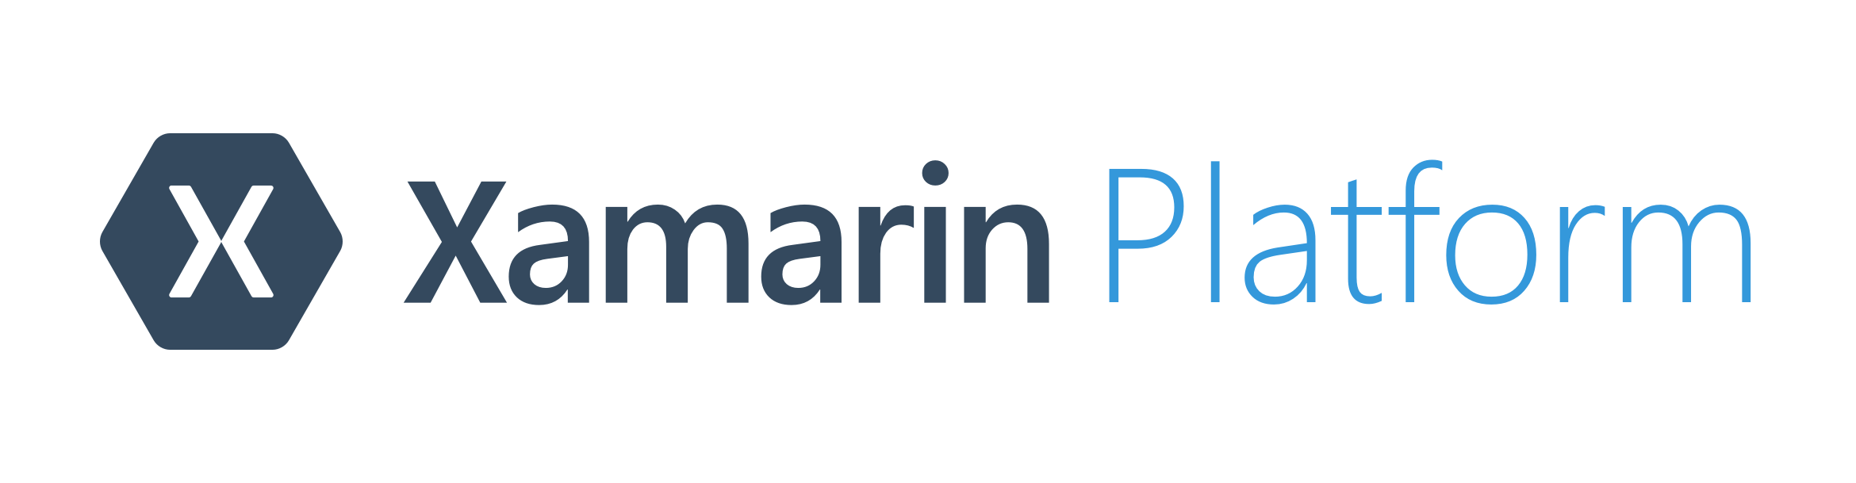
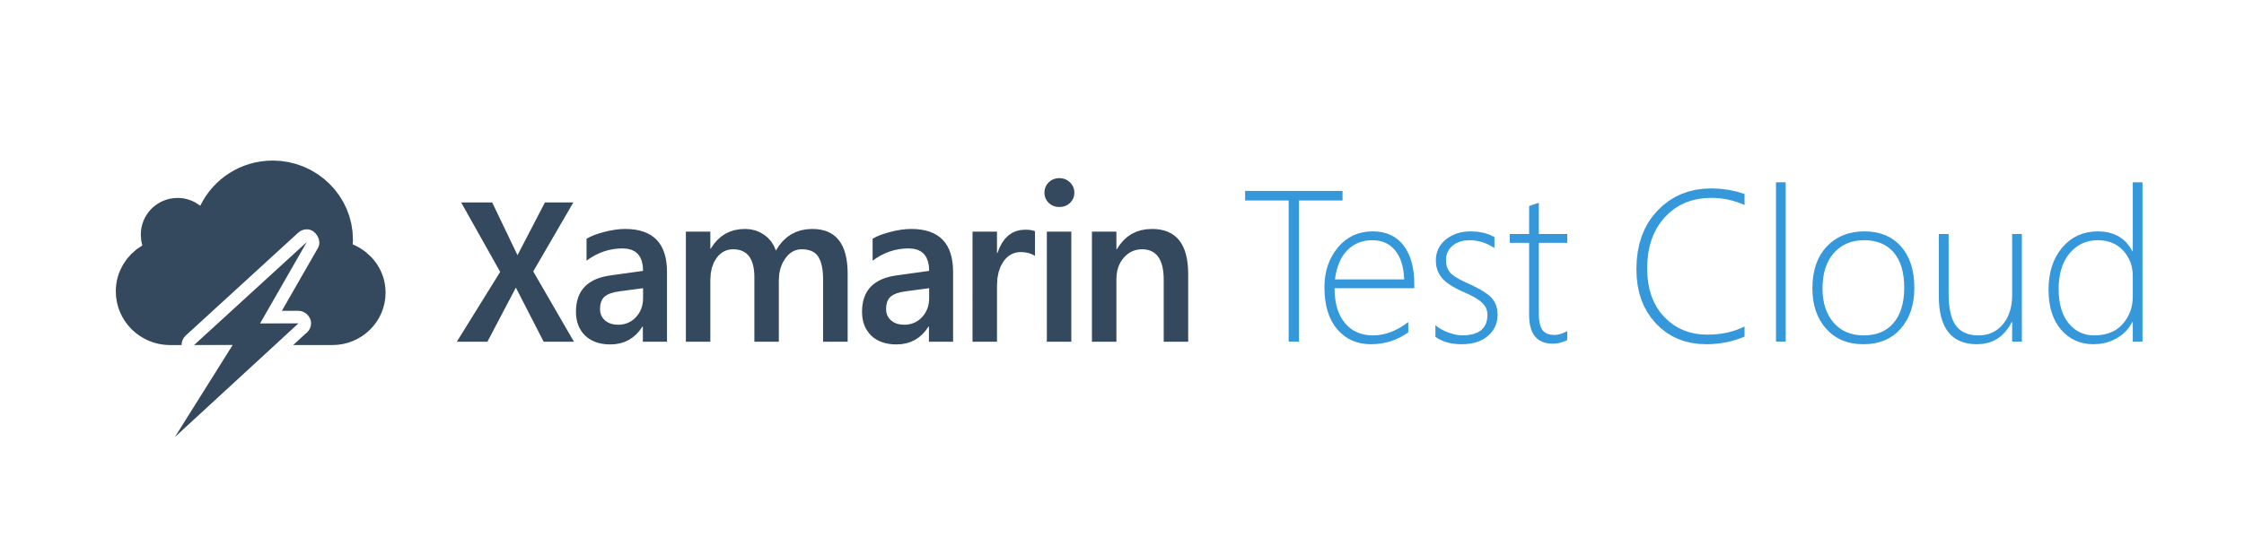
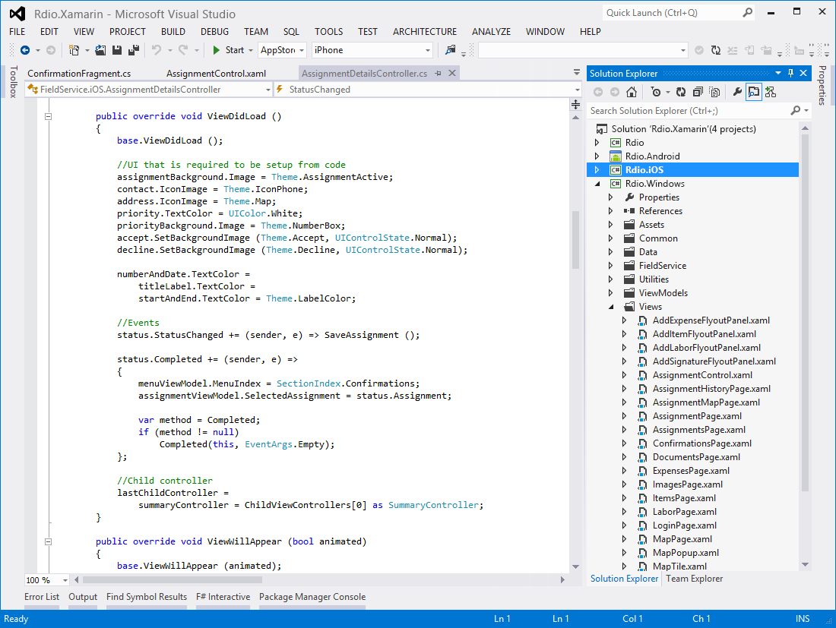
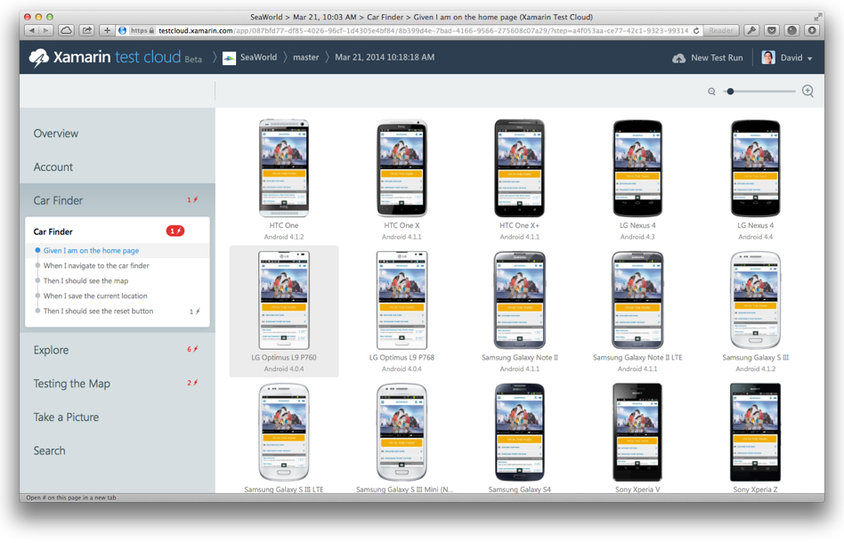
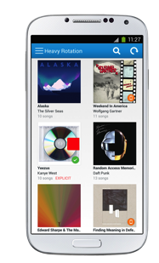
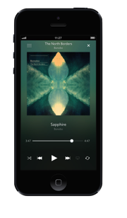
Create native iOS, Android, Mac and
Windows apps in Visual Studio and C#
Automatically test your app on
hundreds of mobile devices
Notes:
If you are new to Xamarin you should know that Xamarin offers a few products.
First is the Xamarin Platform. This is what we will be talking about to today and is where we will be creating native iOS, Android, and Windows apps all in C#.
Second, is a new product called Xamarin Test Cloud. Test Cloud is a unique UI automated testing platform where you are able to create UI tests that run on hundred of physical iOS and Android devices in Xamarin’s test cloud. What is wonderful is that the Test Cloud is open to any iOS or Android mobile app regardless of what programming language or platform it was developed in.

Slide 26
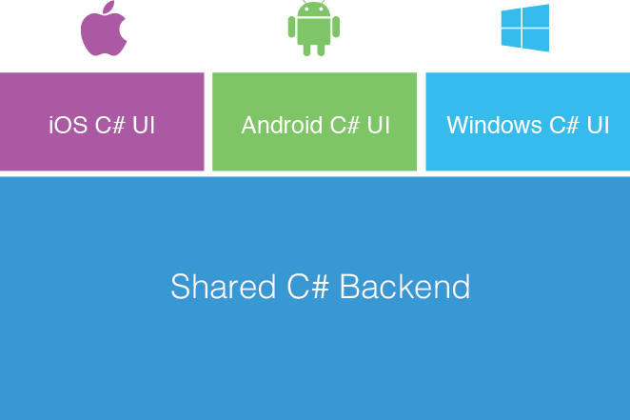
Xamarin’s Unique Approach
Native With
Code Sharing
Notes:
Xamarin’s unique approach enables developers to develop native iOS, Android, and Windows app while creating a shared C# backend (business logic).
You are able to leverage all of your favorite C# features such as async/await, lambas, LINQ, events, delegates, and of course the great .NET Libraries.
Traditionally, with Xamarin you will create a native UI for each platform accessing all of their native controls and native APIs. This development approach can enable you to share on average of 70% of code across all platforms.
We are going to take a look at Xamarin.Forms today, which enables you to share more code, but let’s take a look at what Xamarin development looks like.

Slide 27
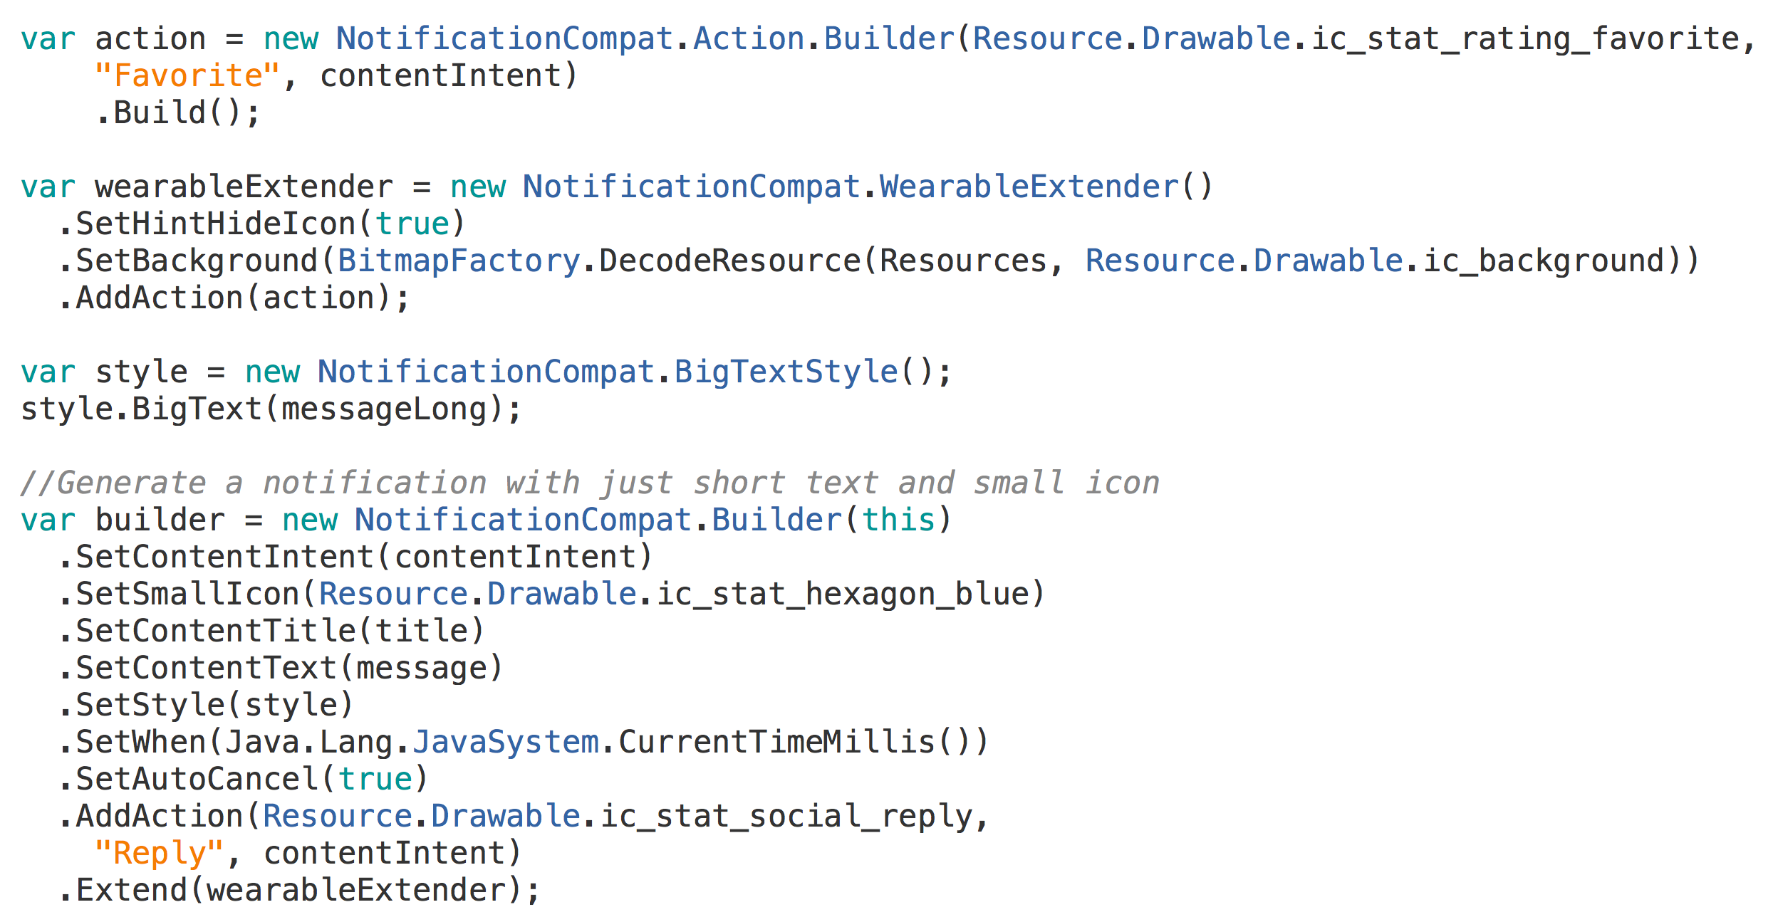

Slide 30
Demo

Slide 31
Notifications Companion Apps Watch Faces

Slide 32
Wearable App Design

Slide 33
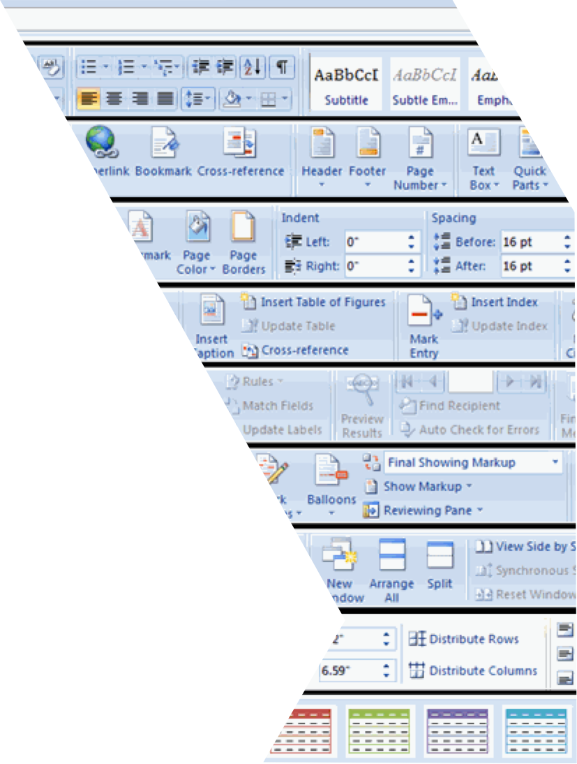
Just because you can…

Slide 34
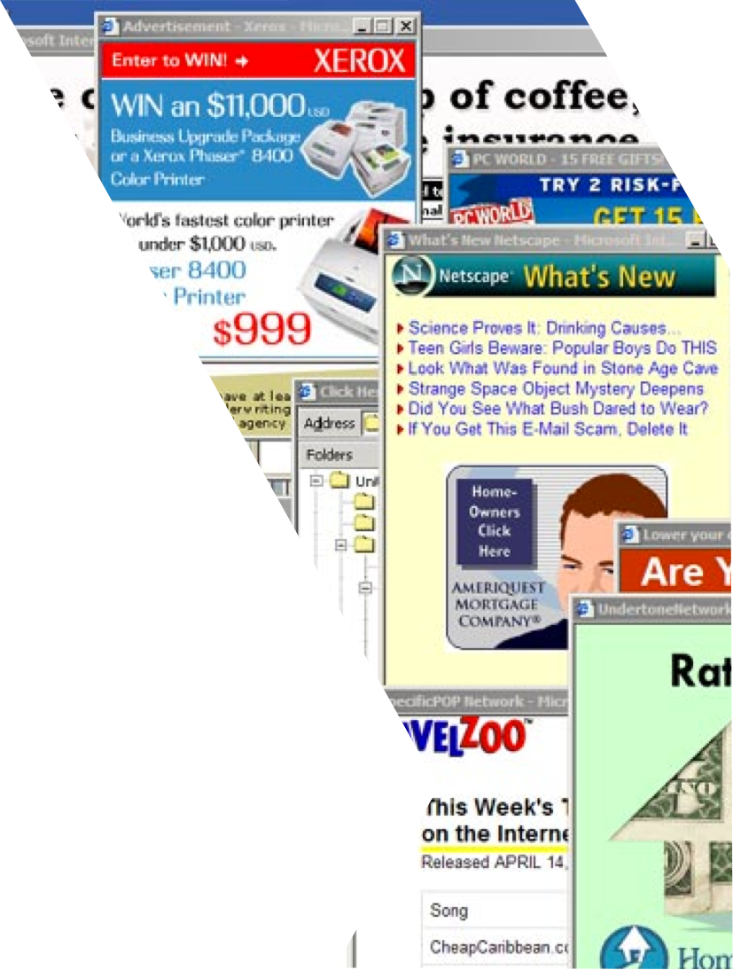
Doesn’t mean you should!

Slide 35

Focus on not stopping the user
5 Second Rule
Notes:
If it takes more than 5 seconds you should make the app more focused
People are usually walking, riding, etc…

Slide 36
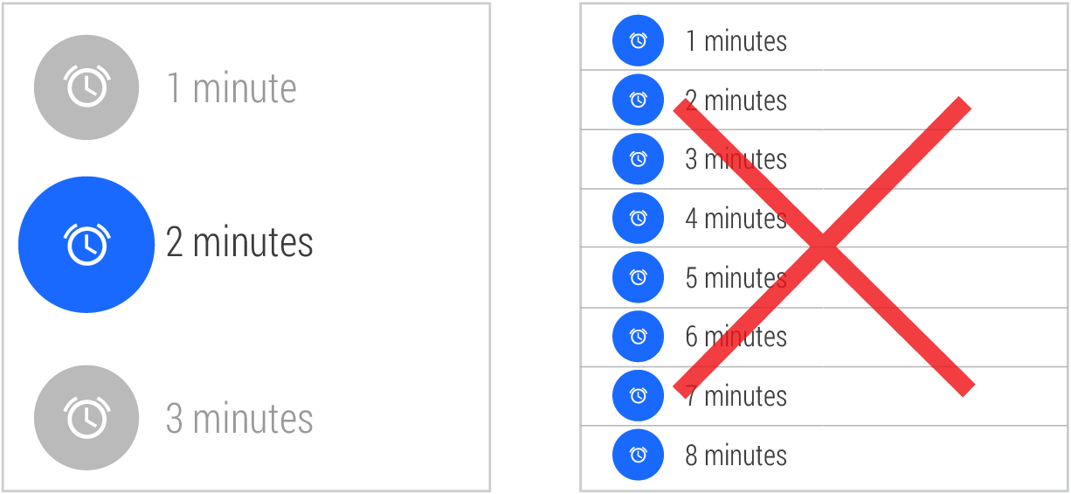
Design for big gestures

Slide 37
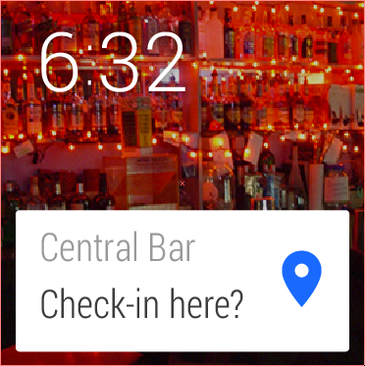
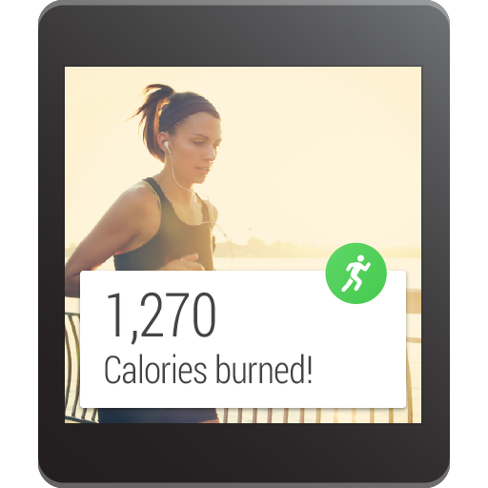
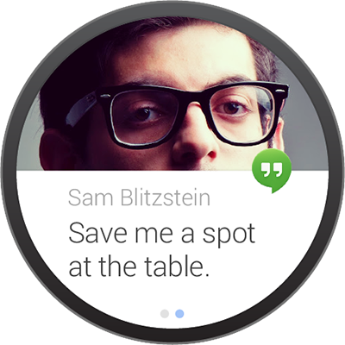
Other tips:
Think stream cards first
Do one thing, really fast
Design for corner of the eye
Don’t be a constant shoulder tapper (aka don’t vibrate the watch)
Be aware of Square and Round

Slide 38
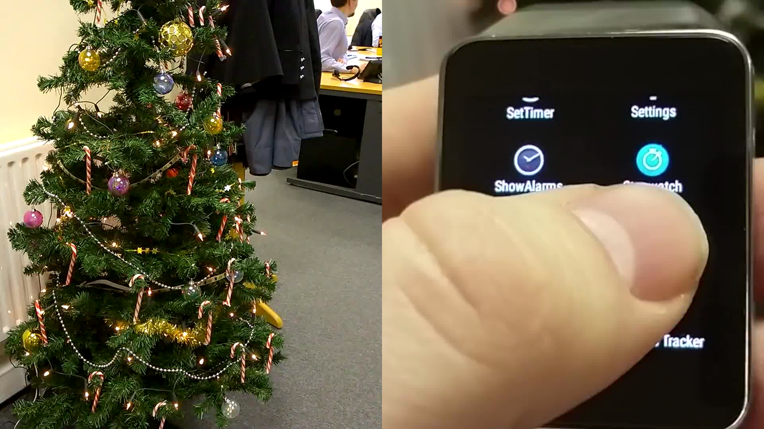

Slide 39
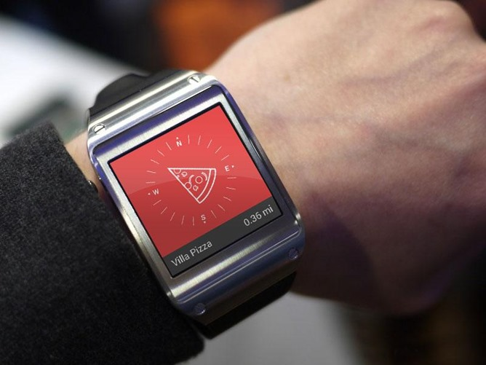

Slide 40
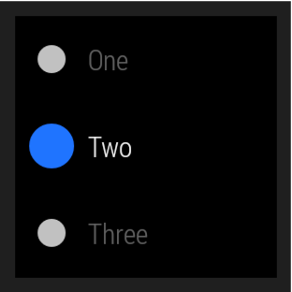
Android Wear – Building Apps
Companion App
Android app that runs on a wearable
New Themes
New UI Widgets
BoxInsetLayout
CircledImageView
WearableListView
More…
http://www.nuget.org/packages/Xamarin.Android.Wear/

Slide 41
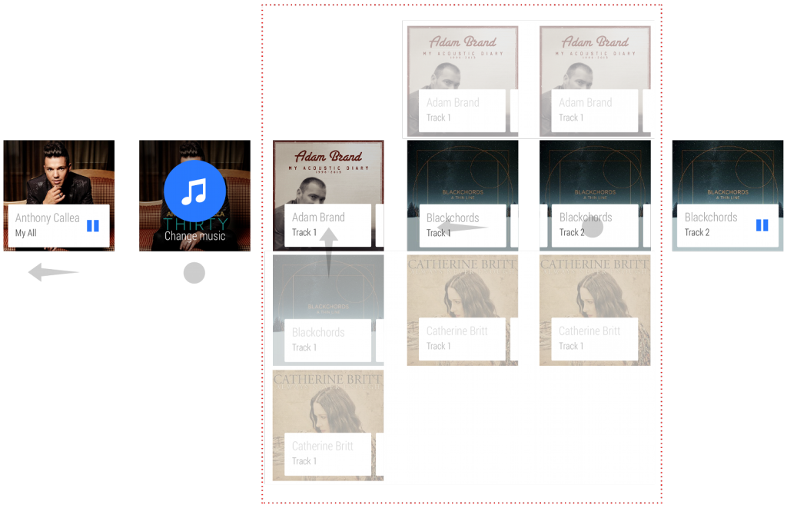
GridViewPager

Slide 42
Demo

Slide 43
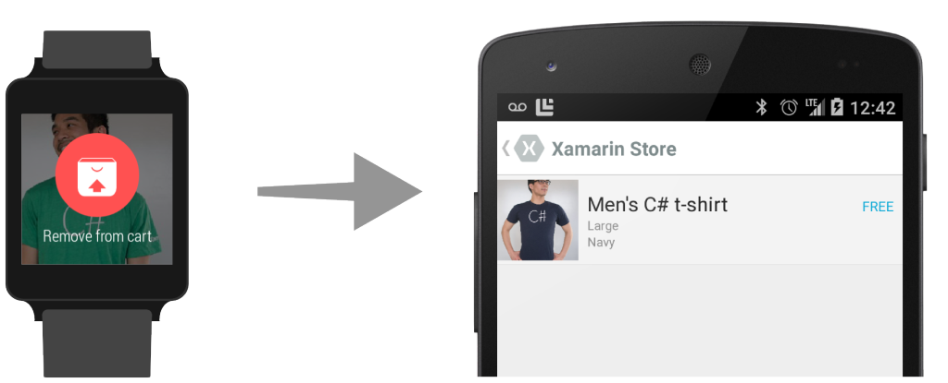

Android Wear – Communication
Data API
Sync datastore between phone and wearable
Message API
Send small payloads and simple
communication
http://www.nuget.org/packages/Xamarin.GooglePlayServices/
Notes:
Only available in Android L Developer Preview

Slide 44
Packaging
Wear apps do not exist on their own
Embedded inside ‘Companion’ apps
Signed with same keystore
Wear app’s .APK file embedded as Asset
Resource XML points to .APK

Slide 45
Notifications Companion Apps Watch Faces

Slide 46
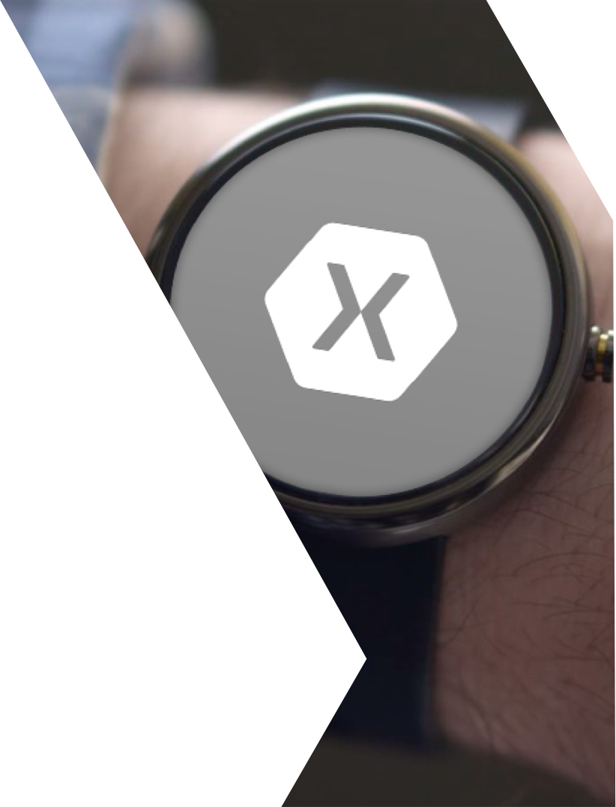
Custom Watch Faces
Wallpaper Service
OnDraw (Canvas)
Still an embedded app
Ambient Mode / Visibility changes

Slide 47
Resources
Tips for Your First Wear App
http://blog.xamarin.com/tips-for-your-first-android-wear-app/
Google Documentation
http://developer.android.com/training/building-wearables.html
Samples
http://developer.xamarin.com/samples/android/Android%20Wear/

Slide 48

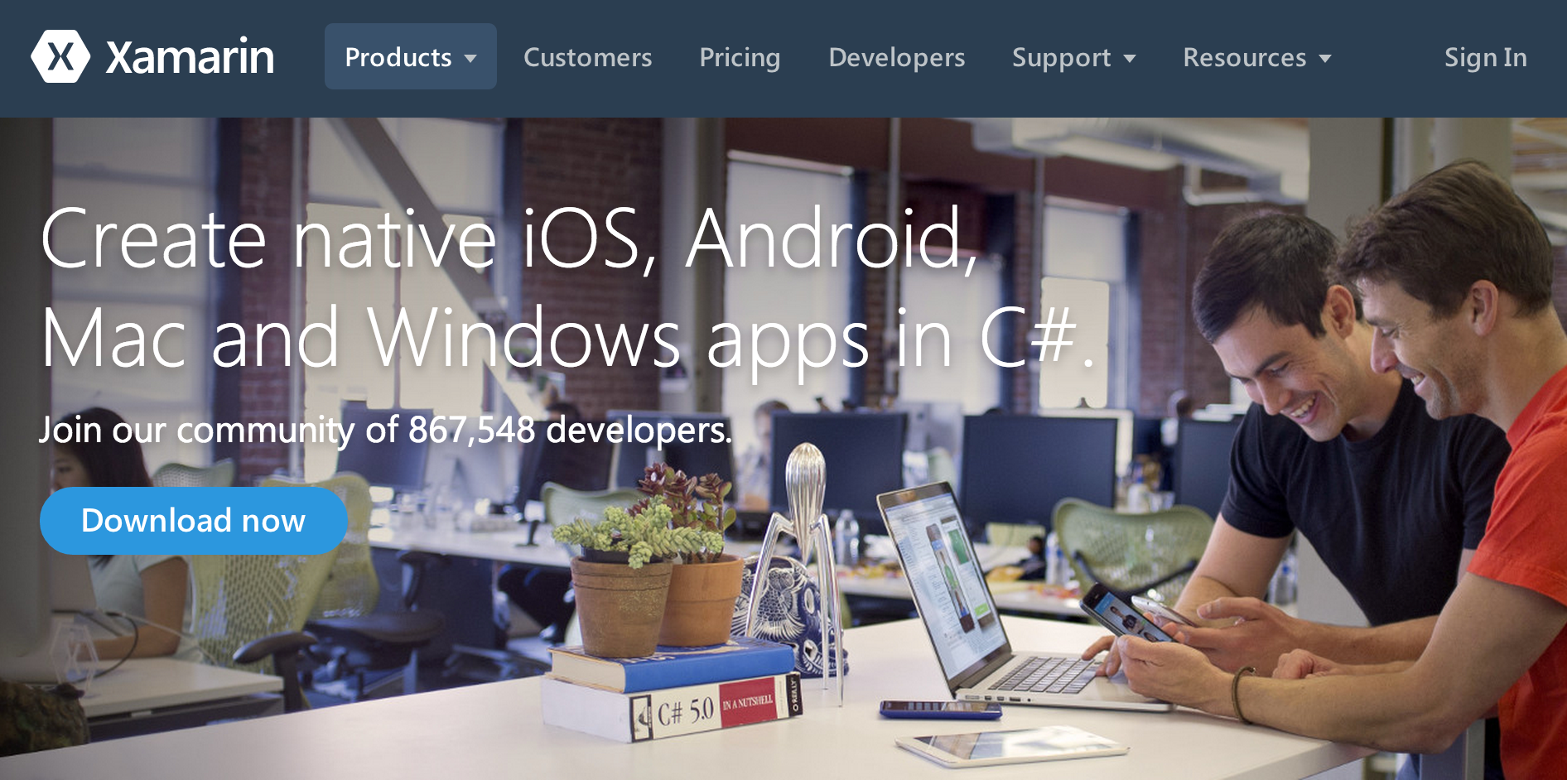
Get Started Today: xamarin.com/download

Slide 49

Find Me:
@JamesMontemagno
@XamarinHQ
http://motzcod.es
http://blog.xamarin.com
Q & A

